Slide 1
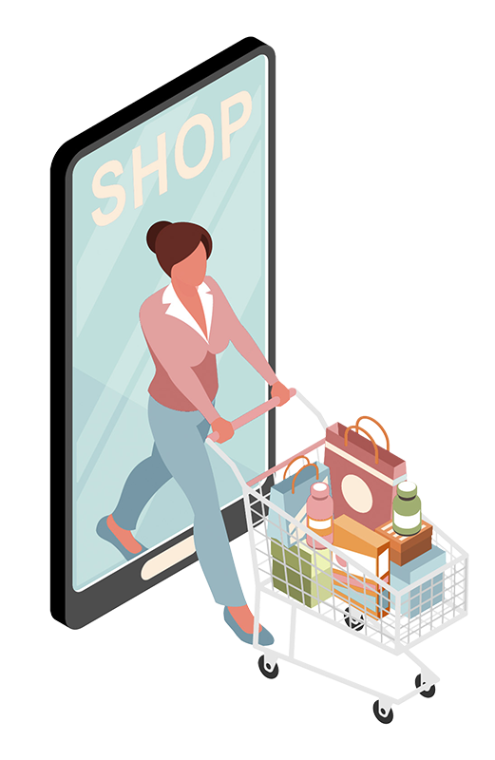
Telegram Shopping Bot
Big Data Engineer Course Final Project
Shira Shimla, Daniel Premisler, Liri Rozenthal
January 2023

Slide 2
01
02
03
PROJECT OVERVIEW
MAIN GOALS
ARCHITECTURE
04
05
06
TABLE OF CONTENTS
TECHNOLOGIES
ETL PIPELINE
POWER BI
DASHBOARD
07
08
09
TELEBOT PIPELINE
CHALLENGES
NEXT STEPS

Slide 3
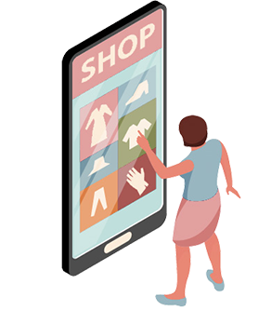
01
PROJECT OVERVIEW
Israel in 2023 is an expensive country to live in, annual inflation rate rose by 5.3%
The inflation was felt in the food industry, unlike other products, food is essential
Tools for price comparison have become essential, particularly in food industry
As we didn't find a convenient tool dedicated to the Israeli market we’ve decided to create one

Slide 4
02
MAIN GOALS
Analysis
Trends
Geo-friendly
Smart consumerism
Store the data and allow users to conduct historical pricing analysis
Create a dashboard and Show price trends over time
Find the best prices in a location convenient to the users
Create a telegram bot that will assist in finding the best prices

Slide 5
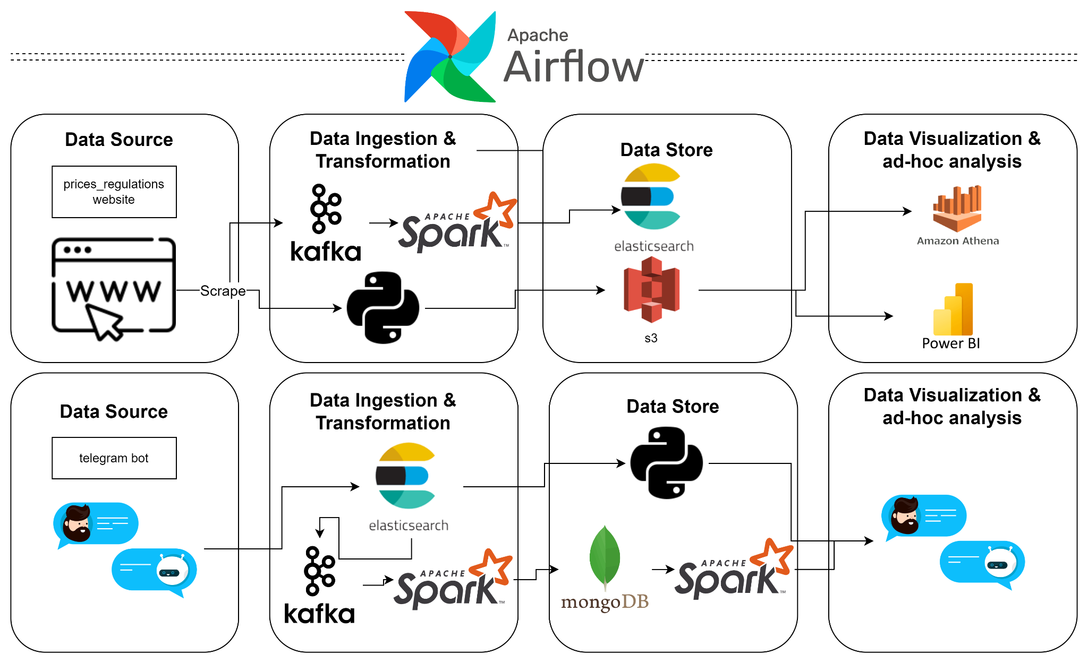
03
ARCHITECTURE

Slide 6





04
ADDITIONAL PACKAGES
Python Packages

Slide 7
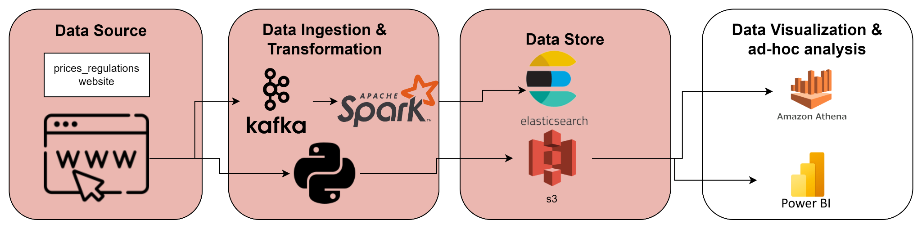
05
ETL PIPELINE
We are daily scraping the retailers’ prices from the Israeli consumer protection and fair trade authority.
We selected the top 3 retailers, Shufersal, Victory and Rami Levi as a case study
Latest prices (max values) + stores’ data (Address etc’) are being sent and stored on ElasticSearch.
All time prices + all time stores’ data (archive) are being sent and stored on S3 Bucket
Saving the files as parquet reduces each file’s size by 90% (20MB —-> 1.37MB).

Slide 8
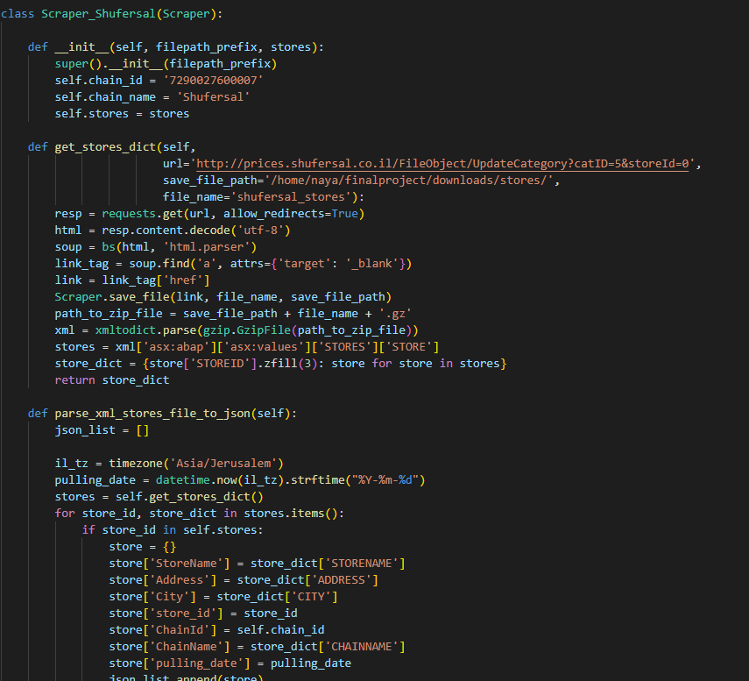
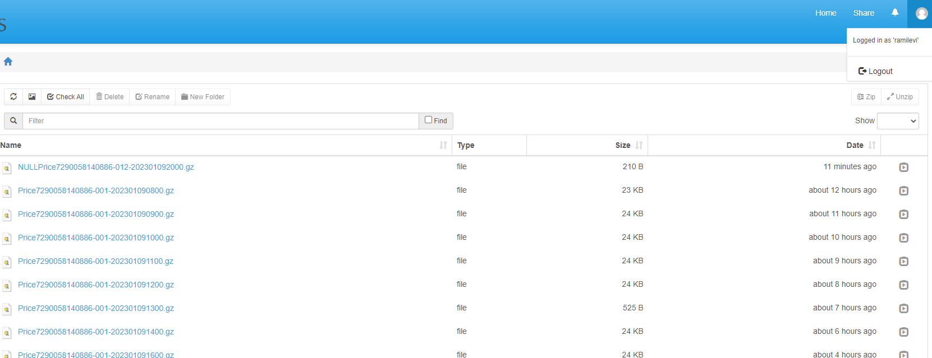
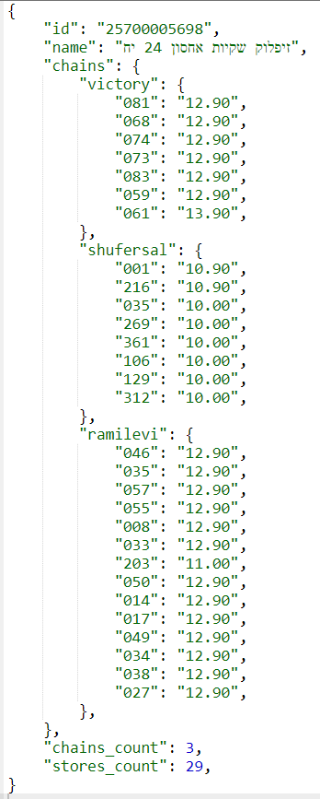
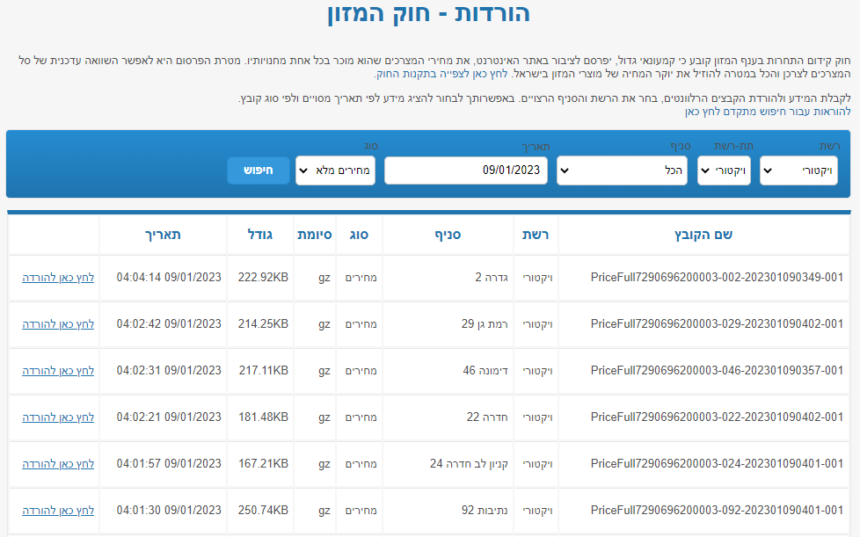
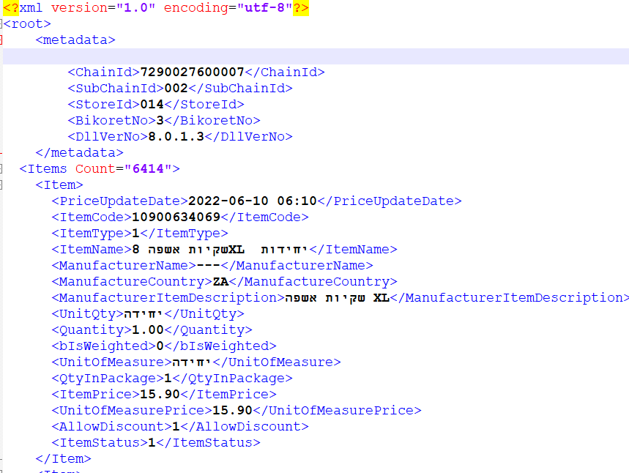
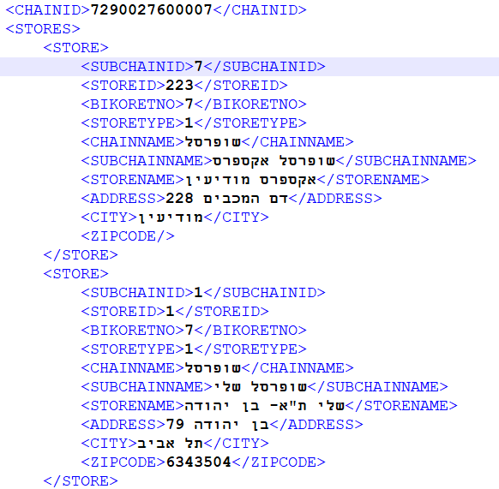
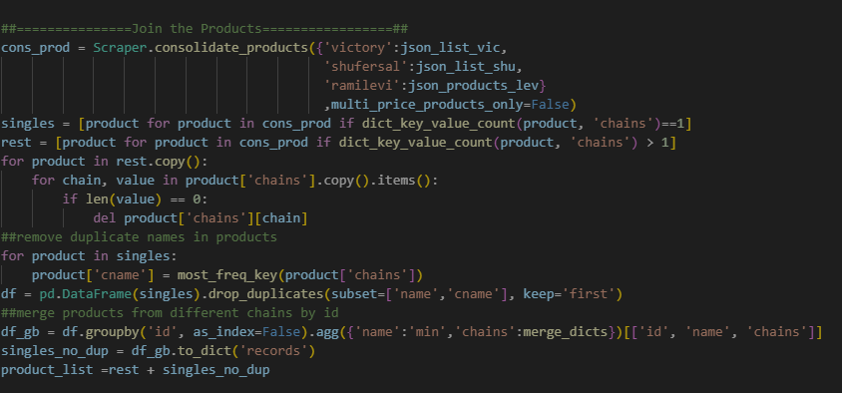
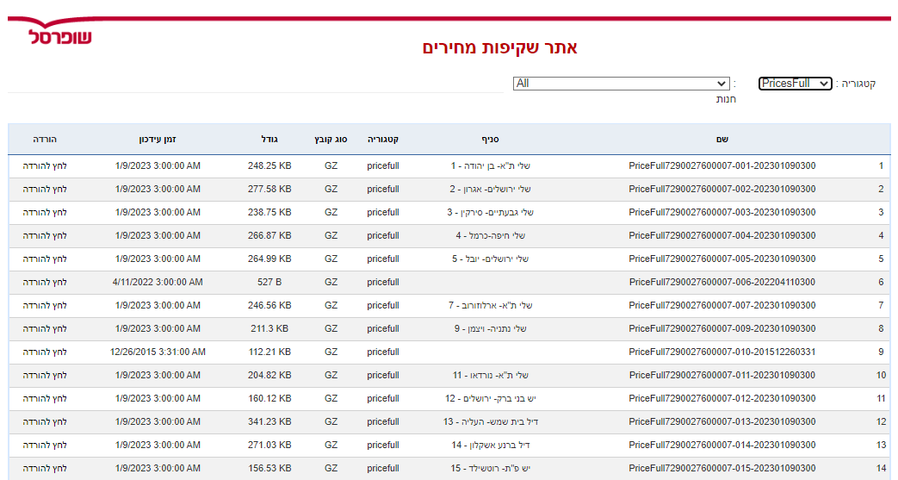
05
ETL PIPELINE - DATA SOURCE
PRODUCTS
STORES

Slide 9
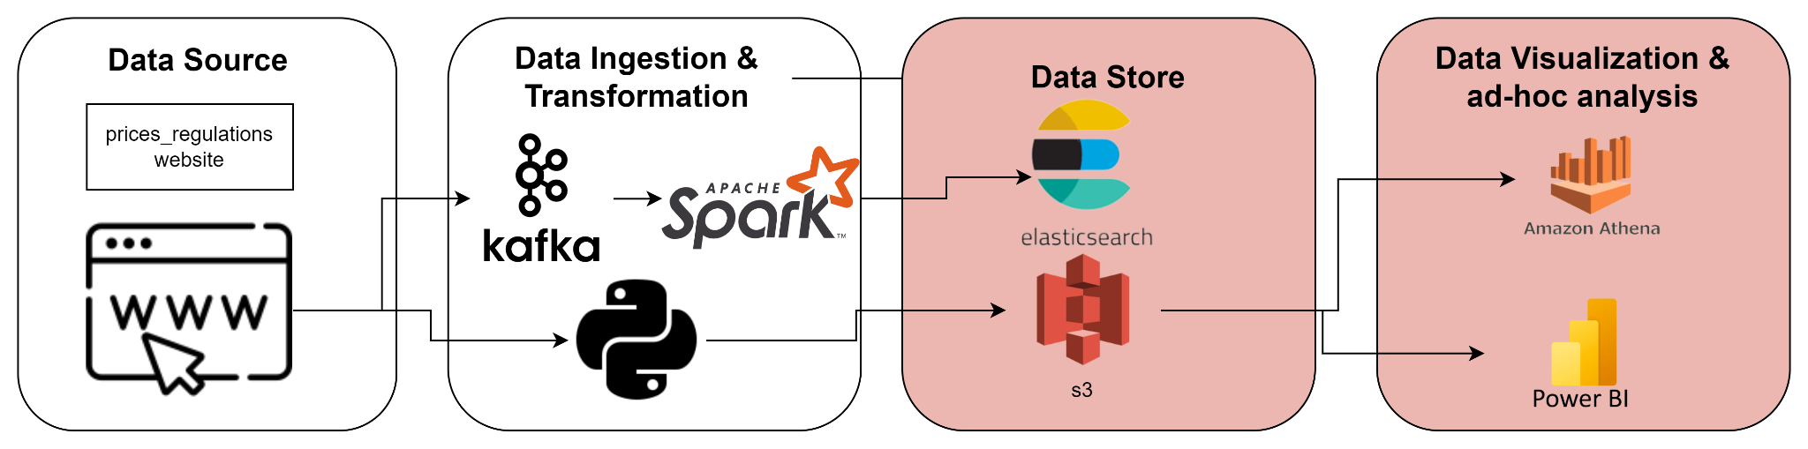
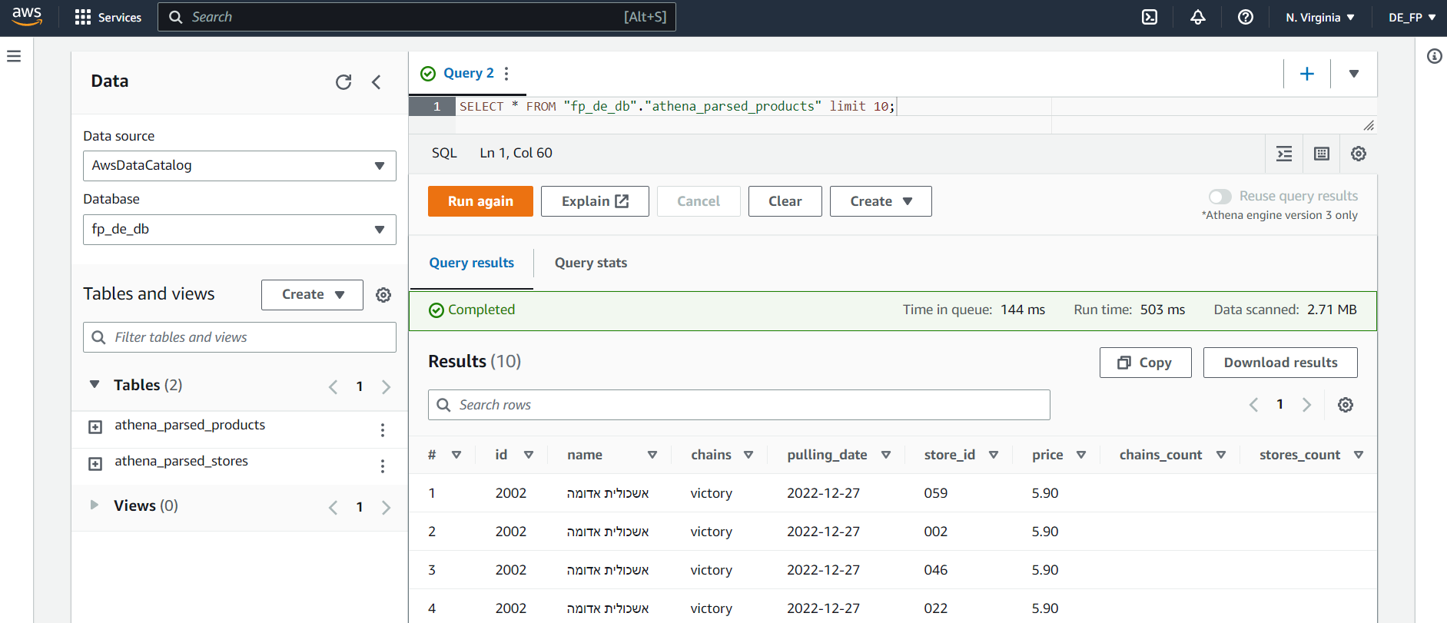
05
ETL PIPELINE
Athena Stores & Product tables allow us to easily query the archive.

Slide 10
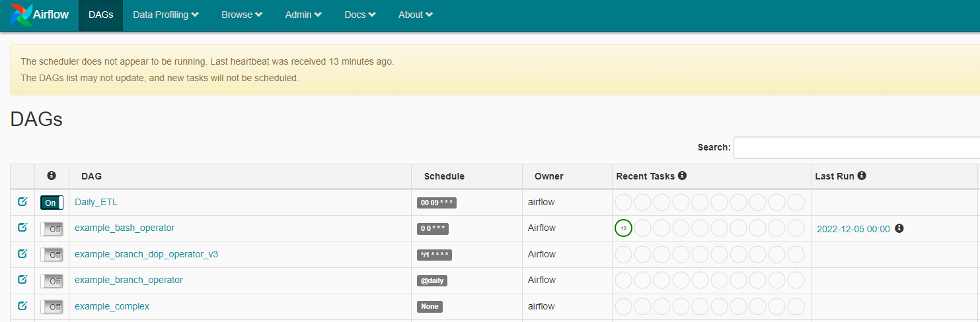
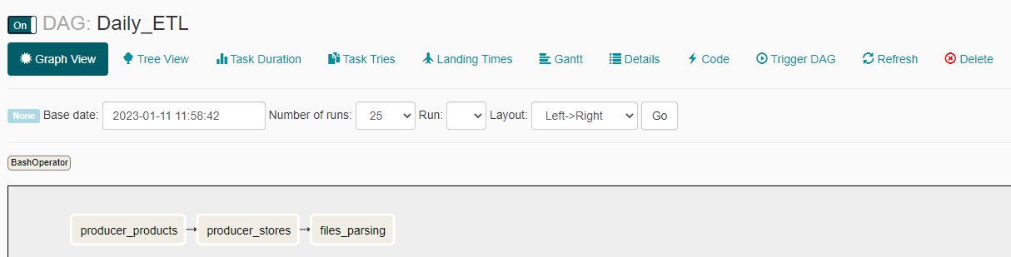
05
ETL PIPELINE
Airflow orchestrates the ETL process.
We’ve created one DAG:
Daily ETL DAG
The DAG is actually performing the end-to-end ETL process - Starting with scraping up until the sending to S3 and ElasticSearch.
The DAG is scheduled to run once a day.

Slide 11
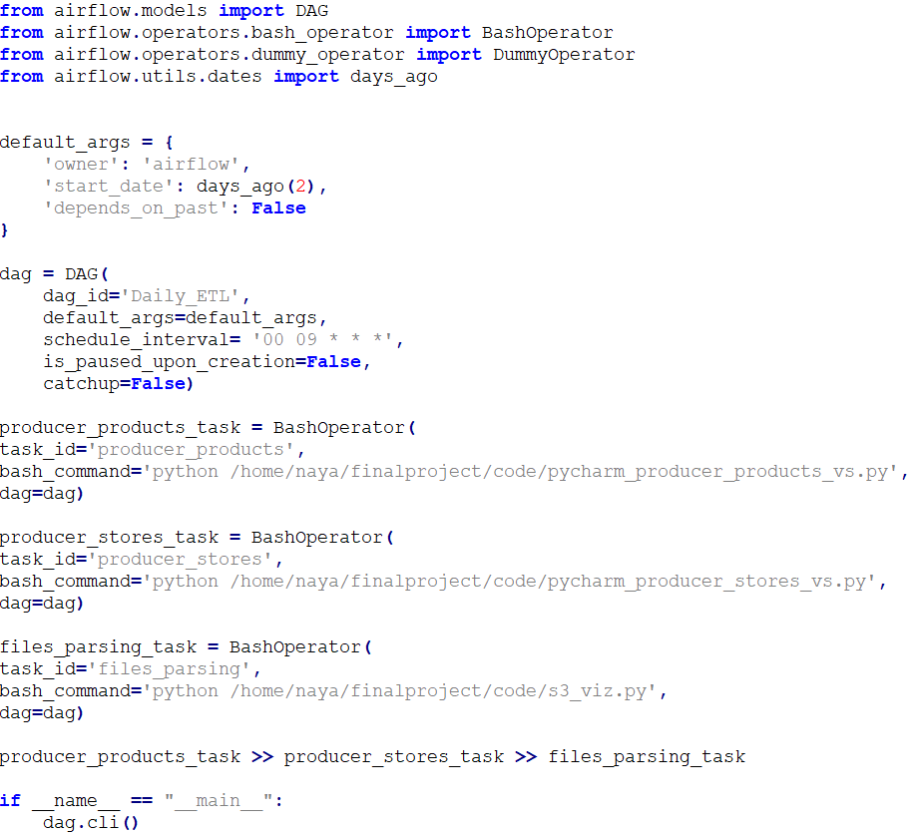
05
ETL PIPELINE
The DAG consists of 3 tasks:
Products scraping and sending to S3 & Elastic
Stores scraping and sending to S3 & Elastic
Parsing the files on S3 to a format that’ll allow loading it to the Power BI
Putting all of the tasks together on the same DAG, and not separating it to three different DAGS, promising there’ll be no overlaps between the DAGS.

Slide 12
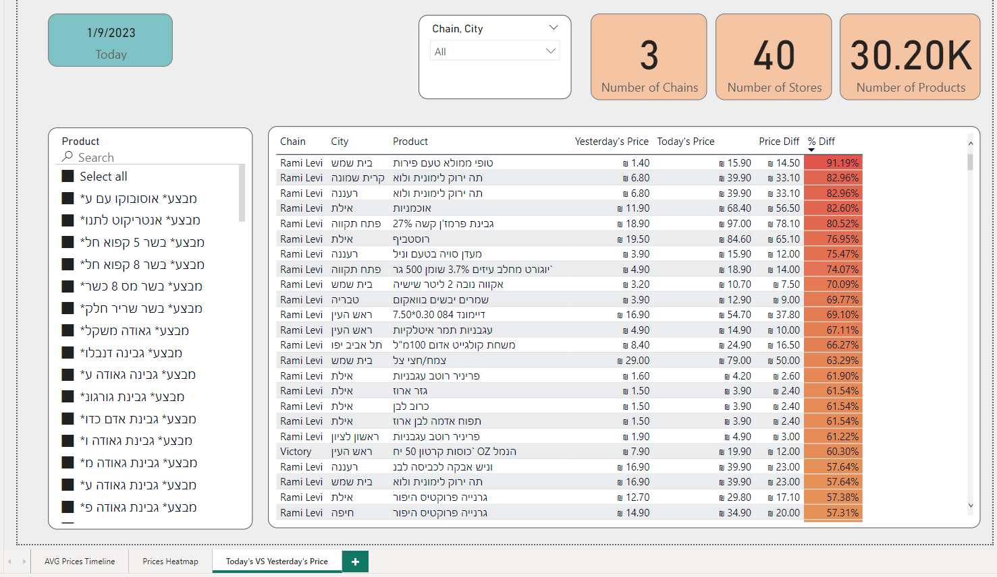
06
Visualisation Tool - Power BI
Comparison tab.
Shows the products that changed comparing today VS yesterday. Only the products that their prices have changed are presented.

Slide 13
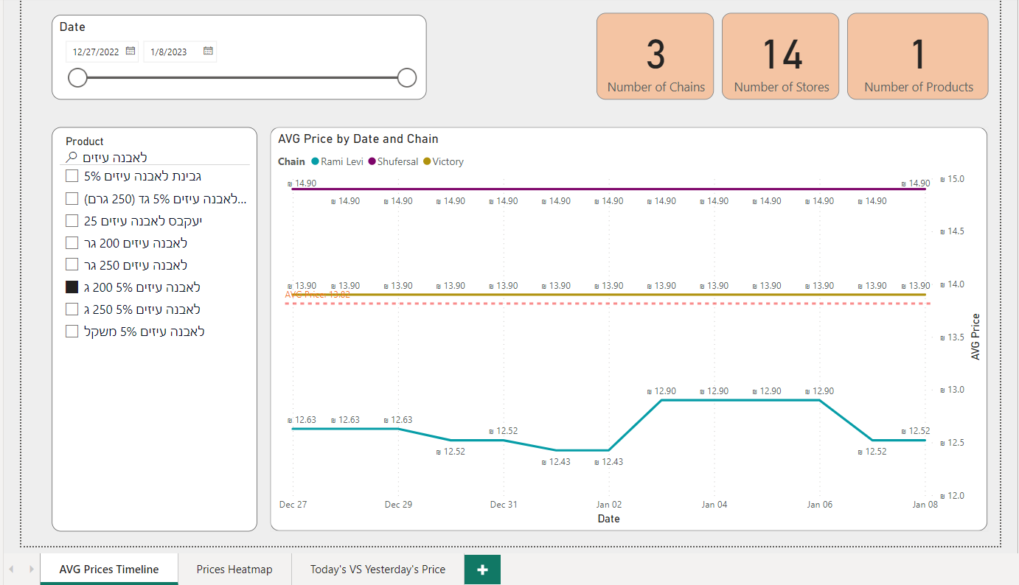
06
Visualisation Tool - Power BI
Product’s price timeline.

Slide 14
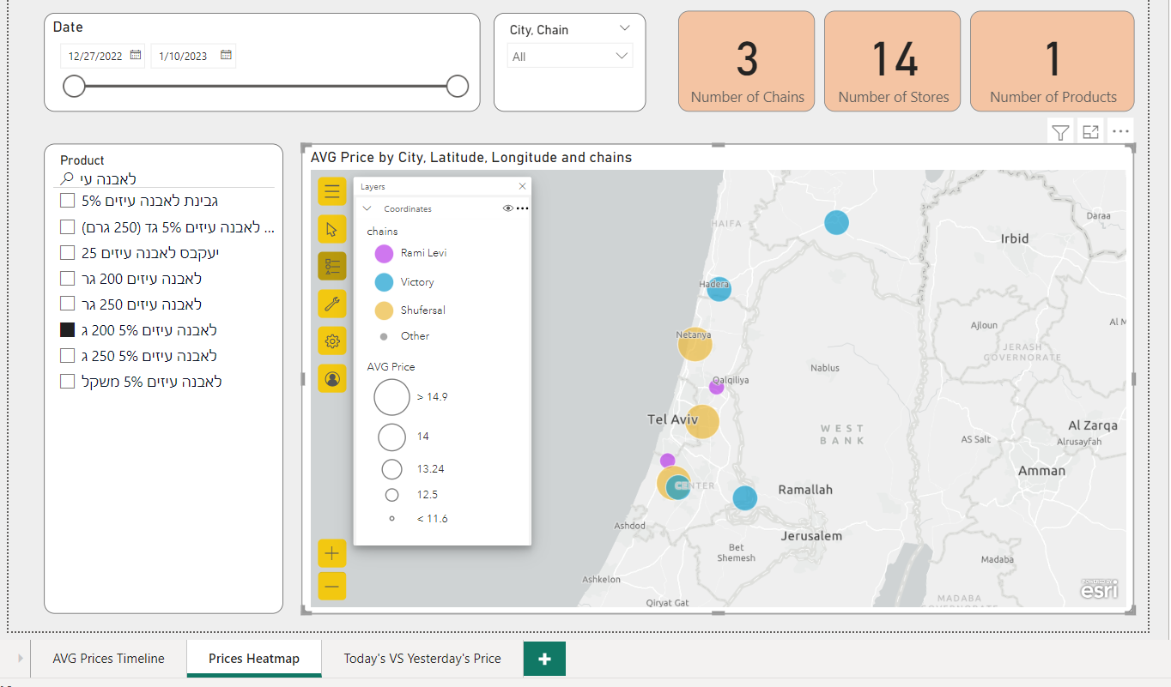
06
Visualisation Tool - Power BI
Product’s prices heatmap.
Shows the prices distribution across all of the retailers and stores all over the country.

Slide 15
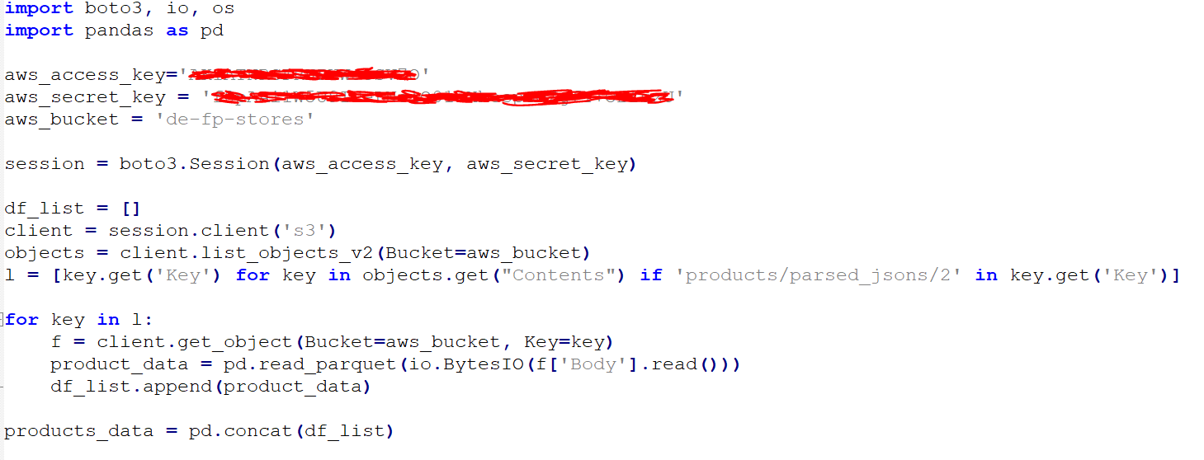
06
Visualisation Tool - Power BI
We are iterating all of the parquet files in the bucket, and load them to Power BI.

Slide 16
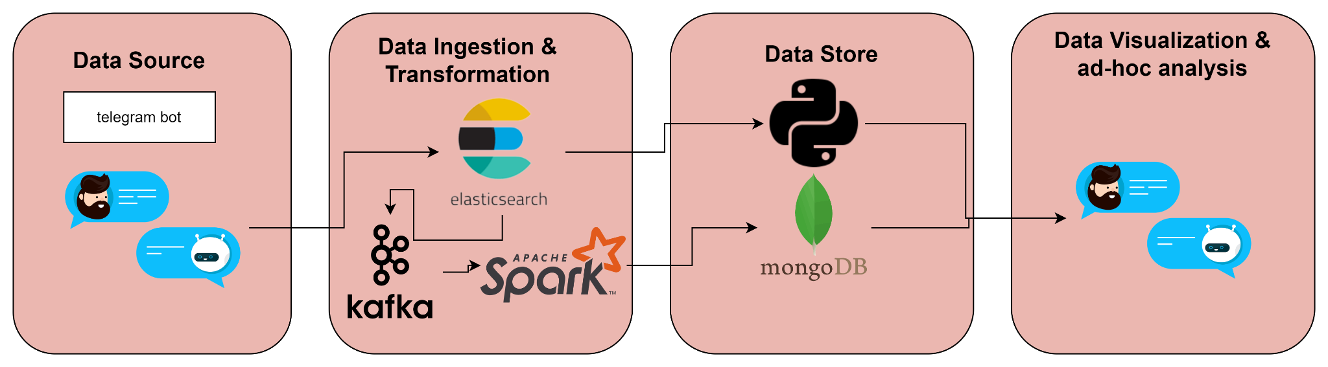
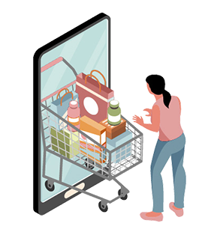
TELEBOT PIPELINE
07
The telebot present two options for the users to do:
compare shopping lists between different retail chains within nearby stores
The data is analysed using elasticsearch and data received from the user regarding his location
Request is sent to mongoDB using kafka and spark
Response regarding which store and chain has the lowest price along with the total price back to the bot handler
5 most common products
The data is analysed using spark on the mongoDB

Slide 17
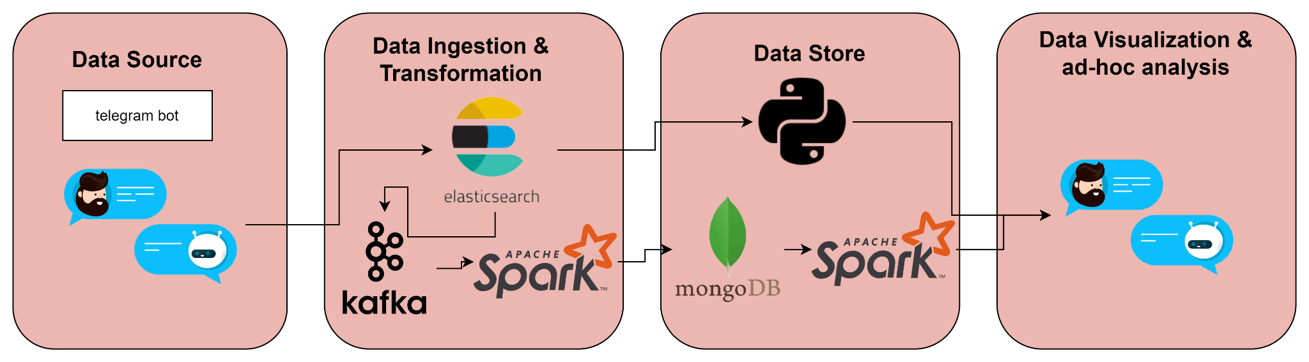
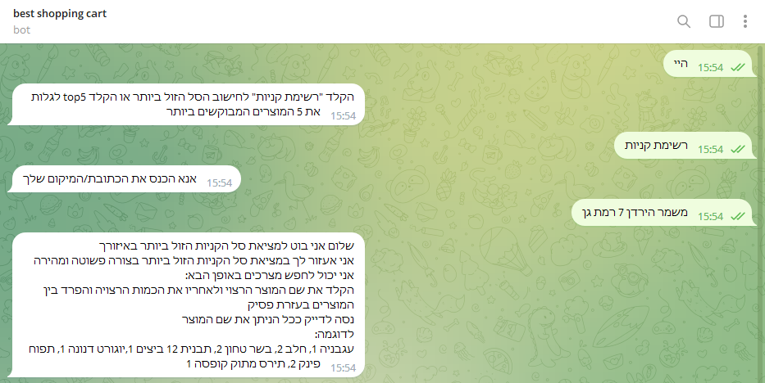
TELEBOT PIPELINE- Demonstration
07

Slide 18
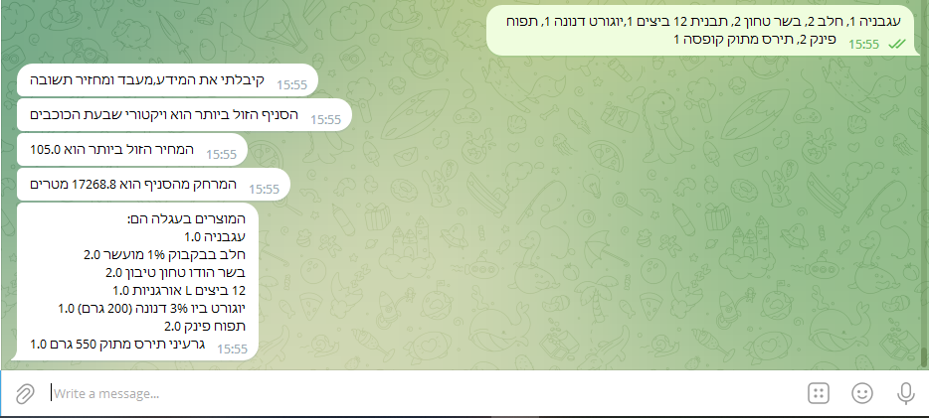
TELEBOT PIPELINE- Demonstration
07

Slide 19
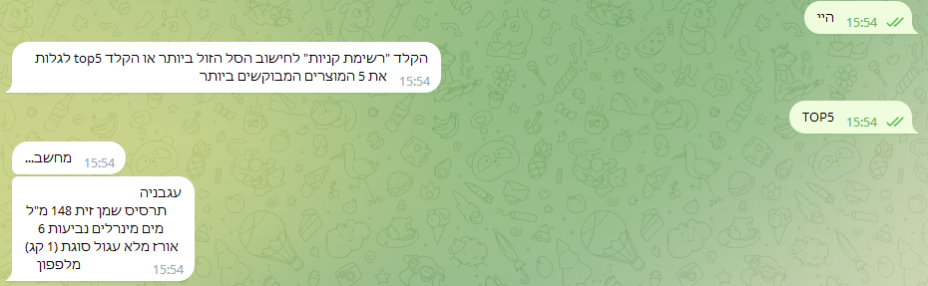
TELEBOT PIPELINE- Demonstration
07

Slide 20
08
CHALLENGES
Data Mashup
Scraping & learning new tech
ElasticSearch query language
Automation
Front end & UI
Integration
Applying Selenium for Scraping data
OOP for scraping
Wrangling messy real life data
Dealing with hebrew language
ElasticSearch Query Tuning and optimization
Applying Airflow in production
Dynamic user inputs
Spark & ElasticSearch
S3 & Power BI

Slide 21
09
NEXT STEPS
Monitoring
Add logging ability to the data pipelines
Improved UI
Data Enrichment
Telegram bot is nice but has limitations lets add a website
Add product categories and product images
Scale Out
Collaborate
Additional Retailers & Branches
Partner with retailers sharing data and using external api for mutual benefit

Slide 22

THANKS
Do you have any questions?
Try our bot search telegram for
“Best shopping cart”

